Slide 1


CNA215 – The Big Picture of the ABAP RESTful Programming Model
SAP CLOUD PLATFORM ABAP ENVIRONMENT
ABAP
SAP HANA

Slide 2



HOW TO MOVE YOUR ABAP SKILLS TO THE CLOUD AND SAP HANA
Optimize Your Custom ABAP Code for SAP HANA
CNA215
CNA120
ABAP Strategy
CNA319
Optimize Your Custom ABAP Code for SAP HANA
CNA215
See the Big Picture of the ABAP RESTful Programming Model
CNA216
A Technical Deep Dive into the ABAP RESTful Programming Model
CNA317
Automated Testing with the ABAP RESTful Programming Model
CNA302
Custom Code Adaptation for SAP S/4HANA
CNA381
Build a List Report App with SAP Fiori and ABAP Programming Model
CNA379
Build a Transactional SAP Fiori App with the ABAP Programming Model
CNA364
Custom Code Adaptation for SAP S/4HANA
CNA654
Build an SAP Fiori App with the ABAP Programming Model
CNA653
Troubleshoot Your SAP Fiori App with ABAP Development Tools for Eclipse
1 hour lecture
2 hours hands-on workshop
1 hour codejam

Slide 3
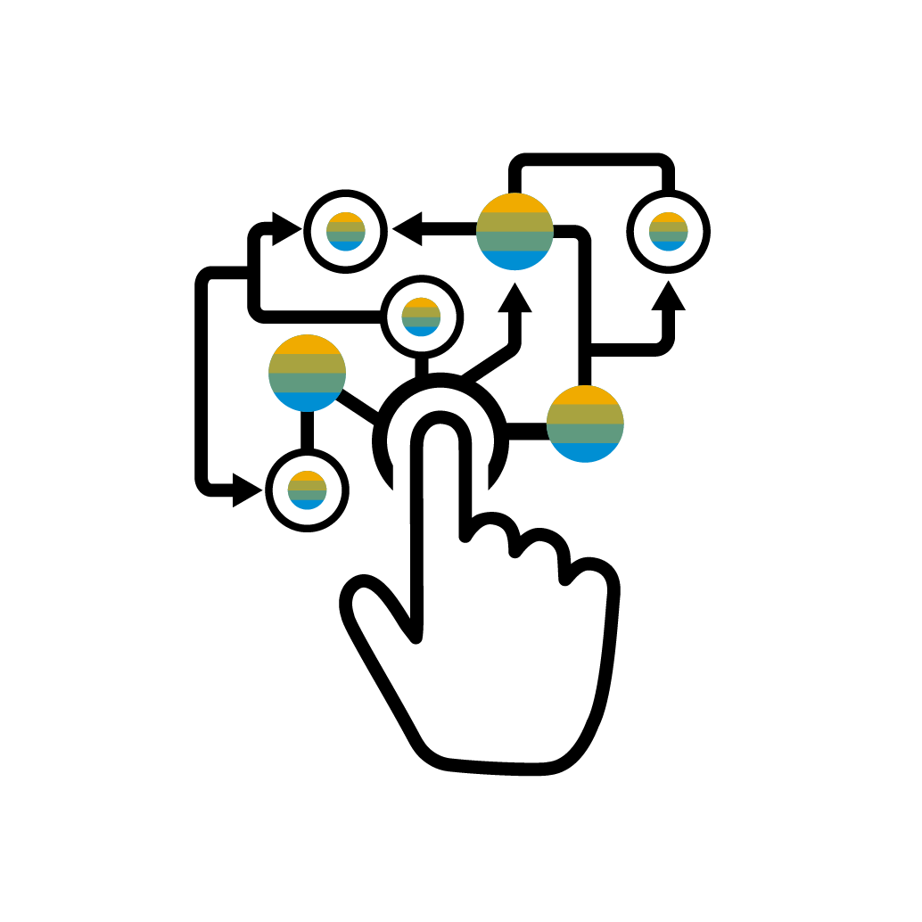
Availability and useful links
The ABAP Programming model in SAP S/4HANA
Available in SAP NetWeaver ON PREMISE releases <= 7.52
Be prepared for the new programming model
Watch TechEd recording from TechEd Barcelona 2017
SAP Cloud Platform ABAP Environment
Today‘s presentation
The ABAP RESTful Programming Model in SAP Cloud Platform, ABAP Environment

Slide 4


For all of you that ...
… are totally new to this programming model topic:
today’s session is optimized for you
… have experiences with the ABAP programming model for SAP Fiori:
evolutionary path in discussion, but this is not detailed today

Slide 5
Programming model: The mission
… for the development of
SAP Fiori apps and
Cloud APIs / A2X services
Other scenarios in ecosystem (e.g. Cloud Migration Cockpit, …)
PROVIDE A PROGRAMMING MODEL …
… offering an end-to-end experience
Tools: standardized development flow
Languages: CDS and ABAP
Frameworks for optimized development efficiency
Documentation: best practices & development guides
… for customers and partners in SAP S/4HANA
… for SAP internal development in SAP S/4HANA
… for customers and partners in SAP Cloud Platform ABAP Environment
… supporting the product qualities
User experience: SAP Fiori and SAP HANA
Cloud: scalability
ABAP assets: non-functional DONE CRITERIA
… and being flexible
Out-of-the-box extensibility & verticalization
Break-outs for non-standardized implementations
Reuse in “freestyle” development scenarios

Slide 6

The golden rules
ABAP Development Tools in Eclipse for all development tasks
Developer on-boarding
End-to-end development flow
Language: ABAP and CDS
Standard implementation tasks via typed APIs supporting
Auto-completion, element info, static code checks
Frameworks
Take over technical implementation tasks
Business logic added in code exits on protocol agnostic layers

Slide 7


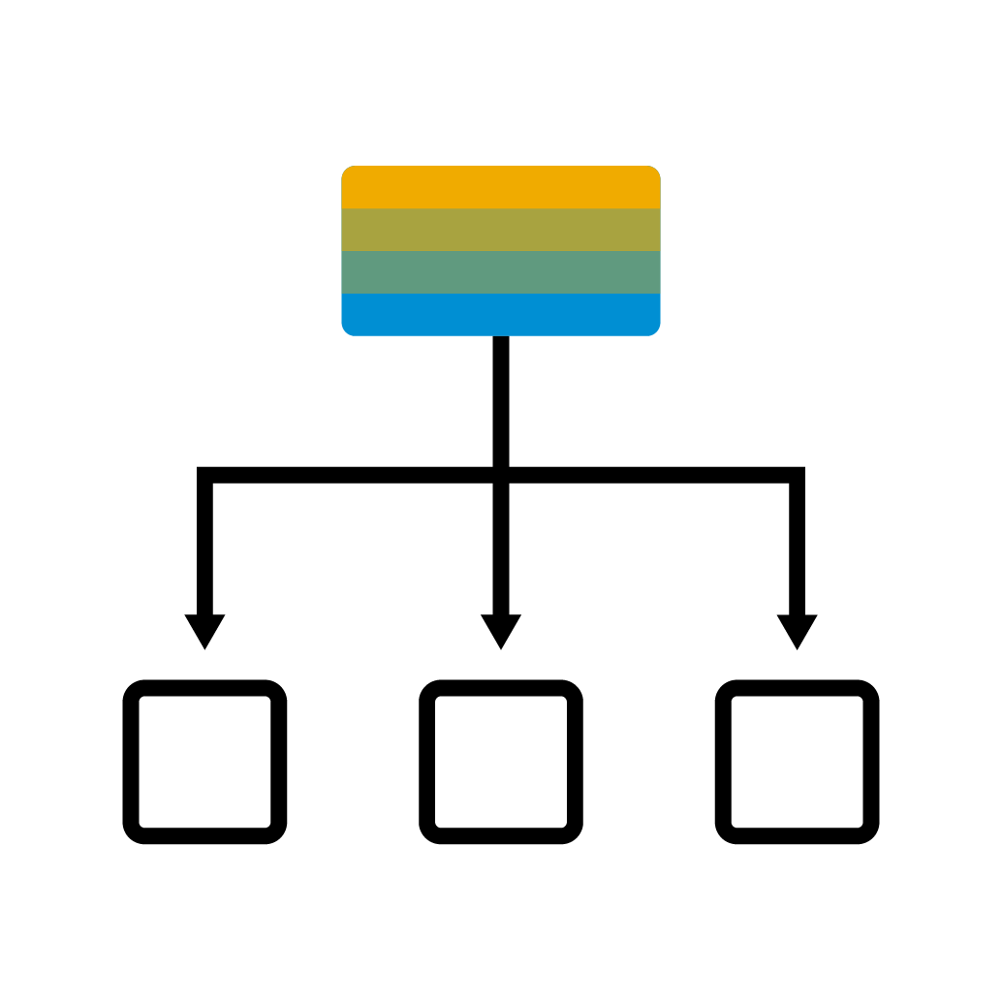


ABAP Development: Must learn topics
SERVICE CONSUMPTION
SAP Fiori UI Consume OData UI services
A2X Consume OData A2X services
SERVICE BINDING Bind the service to OData protocol
BUSINESS SERVICES PROVISIONING
SERVICE DEFINITION Define scope to be exposed
BUSINESS OBJECTS
QUERIES
Data modeling with CDS
DATA MODELING & BEHAVIOR
Data modeling with CDS
Behavior definition
Behaviour implementation

Slide 8

Agenda
What is a Business Object?
What is a Business Service?
The Big Picture
Optional: OData Consumption

Slide 9

WHAT IS A BUSINESS OBJECT?

Slide 10

What is a business object (BO)?
BO BEHAVIOUR
CUD, Actions, Functions, Locks, eTag, Authorizations, Feature Control, Draft
BO STRUCTURE
2
R
1
3
ROOT COMPOSITION
BO RUNTIME
INTERACTION PHASE
TX buffer
SAVE SEQUENCE

Slide 11

Business object runtime
BUSINESS OBJECT RUNTIME
INTERACTION PHASE
SAVE SEQUENCE
MODIFY
READ
LOCK
finalize
check_before_save
execute_action
execute_function
read
create
read_by_association
update
delete
create_by_association
lock
adjust_numbers
save
TX buffer
SAP HANA

Slide 12
Business objects - status overview
INTERACTION PHASE
SAVE SEQUENCE
UNMANAGED
Application coding available (e.g. Purchase Order, Sales Order,…)
1
finalize
MODIFY
check_before_save
LOCK
READ
MANAGED
Green field development
2
adjust_numbers
save
(MANAGED WITH) SAVE SELF-IMPLEMENTED
Update task function module available (e.g. Business Partner, Product,..)
3
TX buffer
SAP HANA

Slide 13

Business objects - unmanaged
INTERACTION PHASE
SAVE SEQUENCE
Application coding
already available
for interaction phase, transactional buffer and save sequence
decoupled from UI technology
Examples
Sales Order, Purchase Order
finalize
MODIFY
checkBeforeSave
LOCK
READ
adjustNumbers
save
APPLICATION CODE
TX Buffer
Adapter
SAP HANA

Slide 14

Business objects - managed
INTERACTION PHASE
SAVE SEQUENCE
Application coding
not yet available or fine granular reusable code available
technical implementation tasks taken over by BO infrastructure
developer focus on business logic, implemented via code exits: determinations, validation, actions,…
Examples
New applications in SAP Cloud Platform ABAP Environment
finalize
checkBeforeSave
MODIFY
LOCK
READ
adjustNumbers
save
MANAGED RUNTIME
TX Buffer
Business Logic via determinations, validations
SAP HANA

Slide 15
Business objects - save unmanaged
INTERACTION PHASE
SAVE SEQUENCE
Application coding
“update-task function module” available
coding for interaction phase not available (e.g. highly coupled in older UI technology: DYNP - PBO / PAI)
technical implementation aspects to be taken over by BO infrastructure
Examples
Business Partner, Product
finalize
checkBeforeSave
MODIFY
LOCK
READ
adjustNumbers
save
MANAGED RUNTIME
Function module for UPDATE TASK
TX Buffer
SAP HANA
Application code in determinations / validations / …
SAP HANA

Slide 16
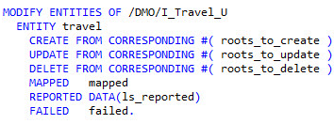
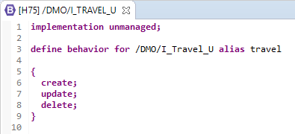
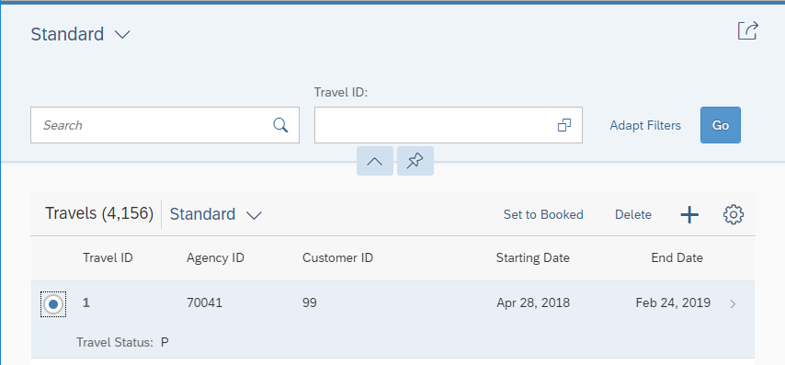
Standard operations - Create, Update, Delete
BO access API can be called (EML)
Define behavior of… { create; update; delete; }
UI reflecting behaviour definition

Slide 17
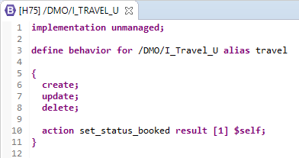
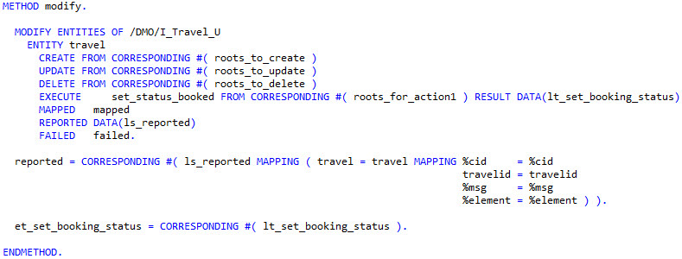


Specific operations- (static) actions
Define behavior of… { action … }
BO access API can be called (EML)
.
UI reflecting definition of specific operations
MDE: expose action

Slide 18
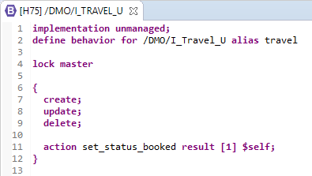
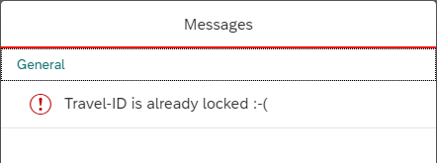
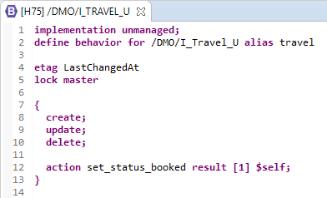
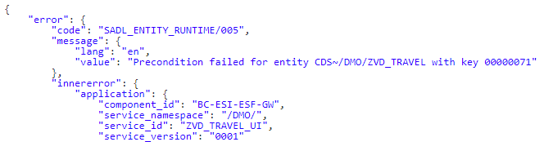
Locks and eTag
Exclusive lock for transactional changes (based on enqueue locks), e.g. in draft UI interaction
BDEF: Lock-master
Error message - e.g. in UI (locks)
Travel-ID is already locked by another user
Optimistic lock (e.g. via timestamp comparison), e.g. in A2X services
BDEF: eTag
Error message - e.g. in A2X (eTag)

Slide 19

Demo
BO modeling and implementation

Slide 20



Next steps planned
Authorizations for CUD via DCL
Feature control
Draft handling
Managed BOs: Determinations and Validations

Slide 21
WHAT IS A BUSINESS SERVICE?

Slide 22
What is a business service?
Protocol and use case
OData V2, V4
A2X or (SAP Fiori) UI
…?
Lifecycle
Release
Versioning
Deprecation
2
3
1
Service Model
4
Tool support
R
UI: SAP Fiori Elements preview
A2X: Documentation preview
Entities to be exposed

Slide 23
SAP Fiori UI and A2X services
A2X
SAP FIORI UI
UI annotation exposure
Not required
Required
Value help
Not required (but replicated code lists)
Required (for UI end-user interaction)
Dynamic feature control
Not required
Required
Draft
Not required
Required
ContentIDs for complex $batch requests
Required
Not required
Release, versioning and deprecation
Required
Not required

Slide 24
Release and versioning of A2X services
SD creates A2X service V1
BUSINESS SERVICE
SD releases A2X service binding for V1
SERVICE DEFINITION
SERVICE BINDING
Serv mySO
M
DATA & BEHAVIOUR
Model
Behaviour
CUD Actions
SD sets A2X service V1 to deprecated
SD implements BO SalesOrder
BO SalesOrder
A2X
OData V2, V4, (SOA)
I
V1
R
C
Model
Behaviour
CUD Actions Locks eTag Draft
Runtime
managed
XOR
unmanaged
Serv mySOV2
SD changes BO SalesOrder incompatible
V2
R
Model
Behaviour
CUD Actions
SD creates improved A2X service V2
SD releases A2X service binding for V2

Slide 25
Demo
Expose Business Object as UI service for SAP Fiori with SAP Fiori Elements Preview

Slide 26

THE BIG PICTURE

Slide 27
ABAP RESTful programming model: Big Picture
SERVICE CONSUMPTION
SAP Fiori UI Consume OData UI services
A2X Consume OData A2X services
SERVICE BINDING Bind the service to OData protocol
BUSINESS SERVICES PROVISIONING
SERVICE DEFINITION Define scope to be exposed
BUSINESS OBJECTS
QUERIES
Data modeling with CDS
DATA MODELING & BEHAVIOR
Data modeling with CDS
Behavior definition
Behaviour implementation

Slide 28
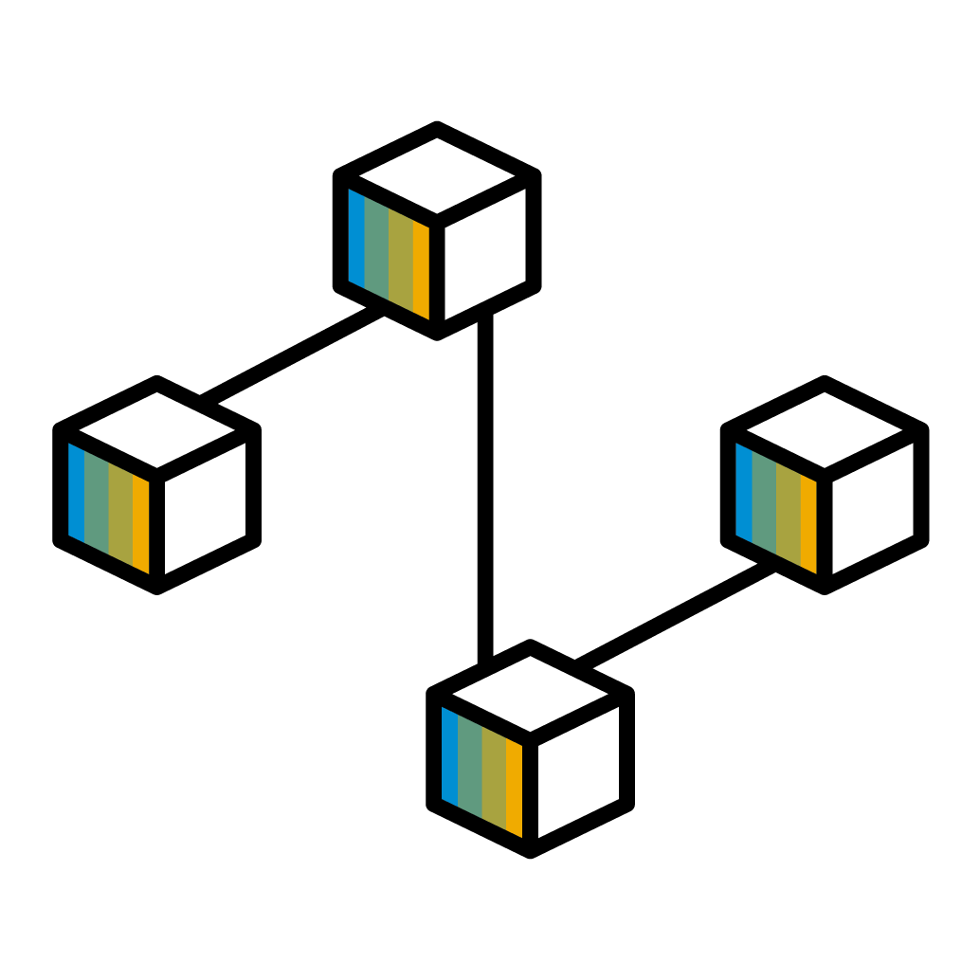
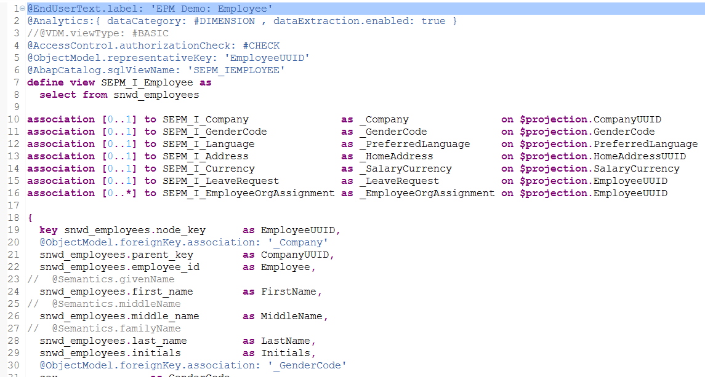
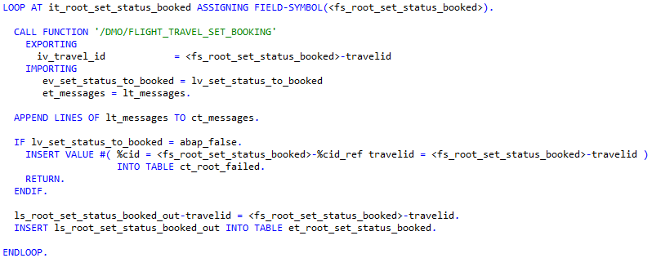
ABAP RESTful Programming Model: Development Flow
Role
DEFINE ROLES
SERVICE BINDING
PREVIEW
DEFINE SCENARIO & PROTOCOL
AUNIT Scenario & integration test
AUNIT Unit test
SERVICE DEFINITION
DEFINE SCOPE
ADD BEHAVIOR
IMPLEMENT BEHAVIOR
Authority object
DCL
QUERY DATA ACCESS CONROL
CDS BASED DATA MODELL
CDS BEHAVIOR DEFINITION
ABAP CODE
AUTHORITY-CHECK
Lock object

Slide 29
Develop SAP HANA optimized SAP Fiori apps
Freestyle or templates based UI development
SAPUI5 / SAP Fiori Elements
SAPUI5
OData protocol infrastructure
SAP Gateway
OData
SAP NetWeaver
SAP Gateway
One common data modelling technology for all scenarios
Core Data Services (CDS)
ABAP Development
Application Frameworks
Core Data Services
Transaction, error and event handling services
CDS behavior (BDEF)
Effective and efficient application development
Modern ABAP language and development tools
SQL
Exploit SAP HANA features and performance
AMDP and CDS Table Functions
SAP HANA

Slide 30

ODATA CONSUMPTION

Slide 31
What is required for a consumption scenario?
Service Proxy API
For OData V2,V4
Based on service consumption model
Service Consumption Model
2
R
1
3
Local representation of the external model
Integration into apps
CDS artifacts not SQL-managed
Data (partly) fetched from remote

Slide 32
Business services big picture - SAP CP ABAP ENVIRONMENT
SAP S/4HANA customer: Bring custom solution into the cloud as Fiori app and A2X service
Solution: Use SAP’s business partner and custom tables, business logic already available
BUSINESS SERVICE UI, A2X, …
SAP CLOUD PLATFORM ABAP ENVIRONMENT
[Consume via OData Client Proxy]
Access remotely SAP’s Business Partner in my S/4HANA cloud instance
BUSINESS OBJECT
Service enabling (unmanaged)
UNMANAGED QUERY
[Custom Query]
Transform BuPa and local data via custom code Service-enable custom code via custom query, fulfilling default Fiori requests (sorting, filtering and paging)
Business Service
CRUDE
QUERY
OData V2 / V4
SAP S/4HANA CLOUD
FM
FM
BuPa
[Business Object – Service Enablement]
Handle modifications of local (and BuPa) data in my custom code Service-enable custom code via business objects
ODATA CLIENT PROXY
[Business Services – A2X / UI]
Expose data to Fiori UI and A2X service
Custom

Slide 33
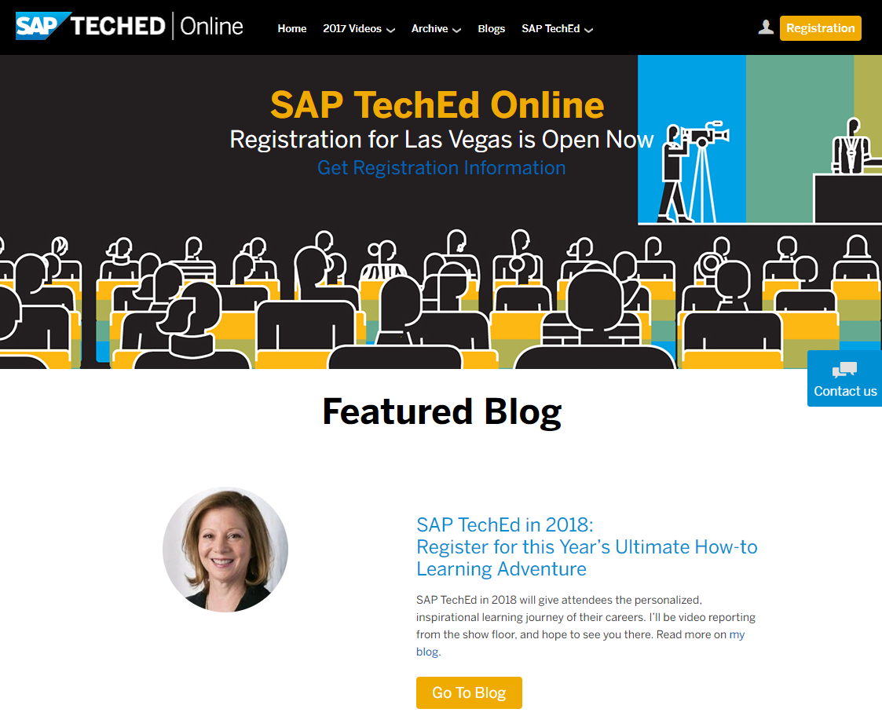
SAP TechEd online / SAP Community
Access replays of:
Keynotes
SAP TechEd live interviews
Selected lecture sessions
http://sapteched.com/online
Continue your SAP TechEd discussion after the event within SAP Community:
Read and reply to blog posts
Ask your questions
Join conversations
sap.com/community
See all SAP TechEd blog posts

Slide 34

Further information
Related SAP TechEd content journeys
CNA6 – How to Move Your ABAP Skills to the Cloud and SAP HANA CNA4 – How to get to SAP S/4HANA
Related SAP TechEd sessions
CNA120 – ABAP Strategy CNA216 – A Technical deep dive into the ABAP RESTful Programming Model CNA317 – Automated Testing with the ABAP RESTful Programming Model CNA319 – Optimize your Custom ABAP Code for SAP HANA CNA379 – Build a transactional SAP Fiori App with the ABAP Programming Model CNA381 – Build a List Report App with SAP Fiori and the ABAP Programming Model CNA654 – Build a SAP Fiori App with the ABAP Programming Model CNA653 – Troubleshoot Your SAP Fiori App with ABAP Development Tools for Eclipse
Public SAP Web sites
ABAP Development Community: https://www.sap.com/community/topic/abap.html SAP products: www.sap.com/products
SAP training and certification opportunities
www.sap.com/education

Slide 35

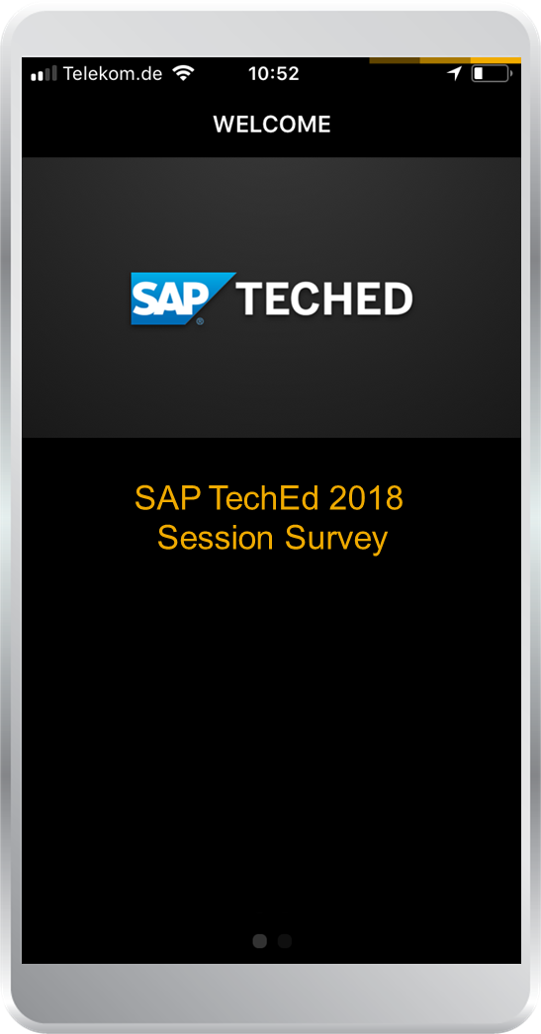
Feedback
Thanks for attending this session.
Contact for further topic inquiries
Please complete your session evaluation for CNA215.
Marcel Hermanns marcel.hermanns@sap.com

Slide 36
Lectures only: Questions for TechEd Journey Badge “exam” pool* / openSAP course SAP TechEd 2018 Recap**
1 What makes up a Business Object in the ABAP RESTful programming model
Structure, behavior and runtime
Root, tribe and leaves
The Birch and Swinnerton-Dyer conjecture
Business Objects are not used at all
2 What’s used to define the data model and the behavior of BOs in the ABAP RESTful programming model
Core Data Services
Complex Data Solutions
Create, Delete and Save
Classified Document Schemes
3 What defines the scope of a Business Service in the ABAP RESTful programming model
Service Definition
Service Binding
Business Object
Behavior Definition
4 Which development tools can be used to develop apps with the ABAP RESTful programming model
ABAP Development Tools in Eclipse
SAP Web IDE
SAP GUI
Notepad

